Slide 1
Report 11/23/2020 Tengteng Tao
Reading Results:
This week, I list and organizing key concepts and equations for 5.6.

Slide 2

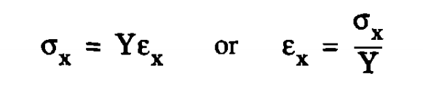
Report 11/23/2020 Tengteng Tao
5.6 Stress:
Tensile stress along one direction causes the material to stretch along that direction by a fractional amount called the strain: (for direction x) .
The yield point is usually defined to be the position that the deviation from linearity reaches 0.2percent.
Up to the yield point, the relationship is linear, and the material is said to be “elastic”.
The slope in the elastic region is a measure of material stiffness and is called the elastic modulus or Young’s modulus.

Slide 3
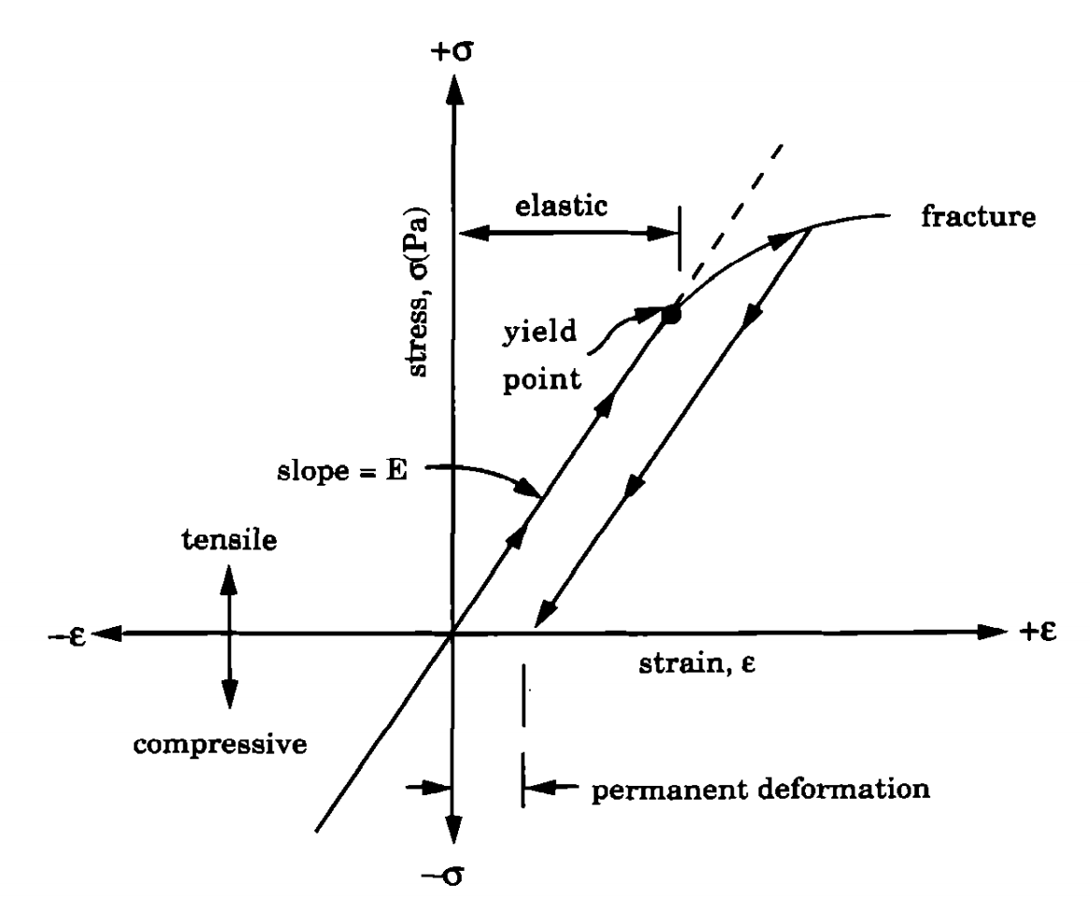
Report 11/23/2020 Tengteng Tao
5.6 Stress:
Characteristics of the stress-strain relationship

Slide 4
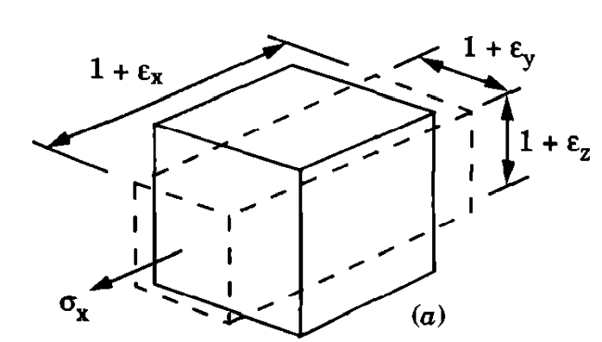
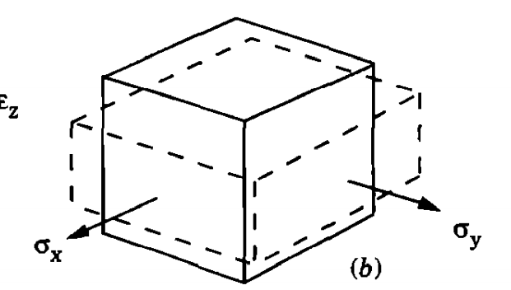
Report 11/23/2020 Tengteng Tao
5.6 Stress:
Uniaxial tensile stress along x in a freestanding sample of material causes stretch along the x direction and also shrinkage along the unconstrained y and z directions.
Since thin-film materials are being pulled on by the substrate in two dimensions, they are always under biaxial stress.

Slide 5
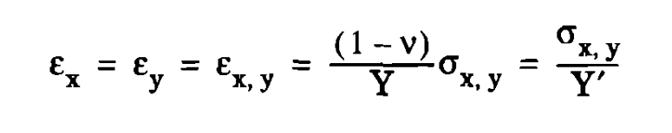

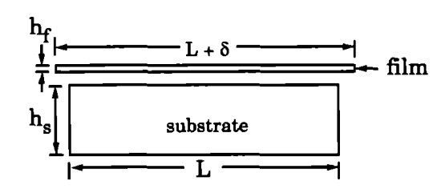
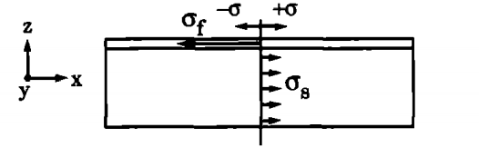
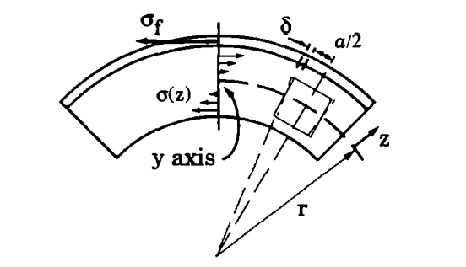
Report 11/23/2020 Tengteng Tao
5.6 Stress:
Corresponding formulas:
Y’ is known as the biaxial elastic modulus
For unit width in y, the force balance in the x direction:
Film unbonded to remove stress Expansion components of
substrate stress Bending component

Slide 6
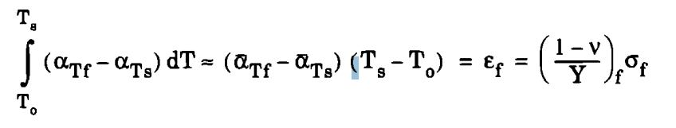



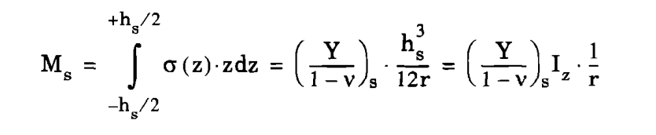
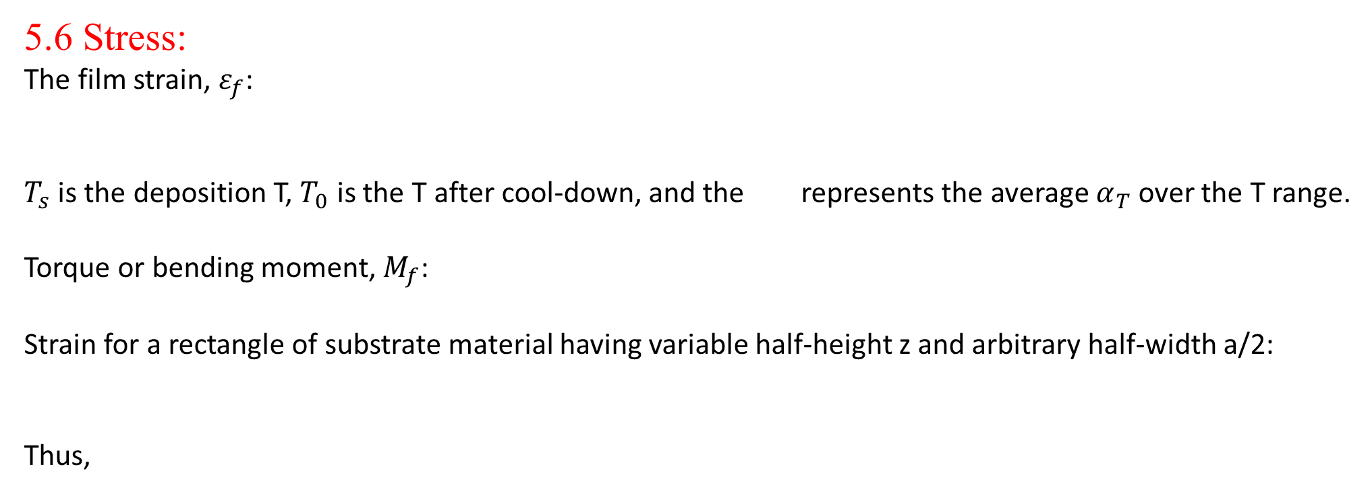
Report 11/23/2020 Tengteng Tao
5.6 Stress:
The film strain, $ε_{f}$:
$T_{s}$ is the deposition T, $T_{0}$ is the T after cool-down, and the represents the average $α_{T}$over the T range.
Torque or bending moment, $M_{f}$:
Strain for a rectangle of substrate material having variable half-height z and arbitrary half-width a/2:
Thus,

Slide 7

Report 11/23/2020 Tengteng Tao
5.6 Stress:
Relationship between total film stress and substrate curvature:
K is the curvature, with positive being convex on the film face and negative being concave.

